Slide 1
THE ALARM OF
EARLY PSYCHOSIS
Psychosis Part 1

Slide 2
In this video, you will learn
The classification of Psychosis
DSM-5 criteria of Schizophrenia¹
Important differences between 1st & 2nd generation Anti-psychotic medications, and their side effect profiles
Role of General Practitioner (GP) in the management of Psychosis in primary care clinic

Slide 3
Role of GP
Keep high index of suspicion for Early Psychosis
Refer for Multidisciplinary management
Co-manage stable patients in partnership with psychiatrist
Monitor & detect early relapse
Monitor efficacy & side effects of medications
Reinforce compliance to medications & psychosocial intervention

Slide 4
Misunderstanding of Psychosis
  It is a split-personality
  No matter what is done, psychotic patients will go downhill rapidly
  Anti-psychotics do more harm than good
  All patients will need Anti-psychotics for life

Slide 5
What is Psychosis?
A Severe Mental Disorder where the individual
LOSES TOUCH WITH REALITY

Slide 6
Clinical significance of Psychosis
3% of general population experience psychotic symptoms²
  20% of which seek help at primary care
1% of population develops schizophrenia
  Peak age of onset: adolescence to young adulthood
  For age 15-44, Schizophrenia is ranked top 3 as the leading cause of disease burden locally (2004)⁴ & top 8 worldwide (2001)³
Disproportionately high social & economic costs
Disproportionately high mortality
1 in 10 schizophrenia patients dies of suicide

Slide 7
Classification of Psychosis^{2,5}
Psychosis
Functional
Organic Causes
Drug/Substance Induced
Brief Psychotic Disorder
(<1 month
Duration)
Brain/
Intracranial
Infection
Metabolic
Endocrine
Autoimmune
Vitamin Deficiency
Illicit Drugs
Alcohol
Medications
Schizophreniform Disorders
(<6 months
Duration)
Head Injury with intra or extra cranial bleed
Brain Neoplasms
Epilepsy
Encephalitis
Meningitis
Septicaemia
Pneumonia
HIV
Neurosyphilis
Renal Failure
Hepatic Failure
Cardio-respiratory Failure (Hypoxia)
Hypo/ Hyperthyroidism
Cushing/
Addison’s disease
Any Electrolyte abnormality eg
  Hypo/HyperNa
  Hypokalemia
  Hypo/ Hyperglycaemia
SLE
Hashimoto’s thyroiditis
Sarcoidosis
Thiamine (B1) deficiency (Korsakoff’s psychosis)
Niacin (B3) deficiency
B12 deficiency
Hallucinogens:
LSD
Magic mushrooms
Ecstasy (MDMA)
Cannabis (in high doses)
Dissociative Drugs:
Ketamine
Dextromethorphan
Stimulants:
Amphetamines, ICE
Antibacterial:
Cefalexin
Ciprofloxacin
Gentamicin
Antituberculous:
Isoniazid
Anticonvulsants:
Sodium valproate
Bromocriptine
Corticosteroids
Schizophrenia
(>6 months
Duration)
Schizoaffective Disorder
Delusional Disorders

Slide 8
Mental State Examination (MSE)
Attitude, Appearance & Behaviour | 25 years old Chinese female, alert, oriented to person, time and place No clouding of sensorium; loose, hanging hair, neat clothing, calm, little eye contact
Affect | Blunted, inappropriate expression of emotions
Mood | Mildly depressed
Thought Process | Loosened association, no flight of ideas
Thought Content | Delusions
Perceptual Disturbances | Mainly auditory hallucination
Speech | Not pressured, no poverty
Cognitive Function | Attention, concentration, memory, understanding Using abbreviated mental test (AMT) ≥ 9/10
Insight | Lacks understanding of her illness, though recognises need for medicine
Suicide/ Aggression | Nil
(Focused Physical Examination is also performed to exclude organic causes and metabolic diseases)

Slide 9
First Rank symptoms of Schneider
(strongly suggestive of Schizophrenia when present)(adapted)⁵
Auditory Hallucinations Voices discussing the patient in third person Voices commenting on the patient’s thoughts or actions Hearing one’s own thoughts being spoken out aloud
Delusions of Thought Interference Thought insertion: The experience of having thoughts put into one’s mind by another person, or thinking someone else’s thoughts Thought withdrawal: The experience of one’s own thoughts being removed from one’s mind Thought broadcasting: The experience that one’s thoughts escape into the outside world and are experienced by others
Delusion of Control Delusions of Control: The experience that one’s thoughts, emotions, impulses or actions are imposed or controlled by an external agent Somatic passivity: The belief that sensation(s) are being imposed upon one’s body by an external agent
Delusional Perception A primary delusion in which a normal perception is infused with a unique and idiosyncratic delusional meaning which does not have any apparent link between the perceived object and the delusion

Slide 10
Laboratory investigations if clinically indicated (adapted)⁵
Investigations | Rationale/Medical Conditions
Full Blood Count, Fasting blood glucose & lipids, Renal function test, Calcium, Magnesium, Liver function test, Urine for drug screening | Screening for Infection & Anaemia Monitor haematological & Baseline assessment for metabolic diseases before starting antipsychotics Electrolytes abnormalities Alcoholic consumption
Vitamin B12, Folate | Nutritional encephalopathies, Dementia
Thyroid Function Test | Hyperthyroidism, Hypothyroidism
HIV, VDRL/TPHA | HIV opportunistic infections, Neurosyphilis
Brain CT | Brain tumour, Head injury
If necessary, screen for | Epilepsy, Cushing’s Disease, SLE, Hashimoto’s encephalopathy Anti-NMDA receptor encephalitis, Wilson’s Disease Inborn errors of Metabolism

Slide 11
Jane fulfils the DSM-5 Diagnostic Criteria of Schizophrenia (simplified)¹
A. Two or more symptoms: | Delusions | √
 | Hallucinations | √
 | Disorganised (bizarre) speech | √
 | Disorganised (bizarre) behaviour | √
 | Negative symptoms (emotional blunting, apathy, avolition, poverty of speech, asocialisation, anhedonia, inattention) | √
B. Duration | 1 month of constant, characteristic symptoms | √
 | 6 months of continual symptoms | √
C. Exclusion Criteria | Exclude schizoaffective disorder, mood disorder, autism spectrum disorder, organic psychosis or substance use disorder | √
D. Function | Social / Occupational Dysfunction | √

Slide 12
For Jane
Her short-term prognosis depends on response to treatment
Her long-term prognosis appears fair
She has a long duration of about 5 years of undiagnosed psychosis, with negative symptoms
Predisposing factor: positive family history
Precipitating factor: exam stress in university
Perpetuating factor: family’s belief in spiritual possession (for family counselling), inadequate insight
Protective factor: good premorbid function, cheerful & outgoing personality, above average IQ, not cognitively impaired, supportive family
When adequately treated, 50% of patients are able to maintain satisfying quality of life in the community despite symptoms.⁶

Slide 13
PSYCHOSIS
PHARMACOTHERAPY
AT A GLANCE

Slide 14
History of Antipsychotics^{2,5,8}
Electroconvulsive Therapy (ECT)
Chlorpromazine
Trifluoperazine
Fluphenazine
Clozapine
Risperidone
Quetiapine
Aripripazole
Haloperidol
Olanzapine
Ziprasidone
1940 1950 1960 1970 1980 1990 2000
1st generation antipsychotics
2nd generation antipsychotics

Slide 15
Table of General Differences Between 1st & 2nd Generation Anti-Psychotics (AP)^{2,5}
 | 1st generation AP | 2nd generation AP
Dopamine Antagonists | +++ | ++
Mechanism of action | Non-selective for Dopamine (D2) receptors: at 60% D2 occupancy, mesolimbic/cortical tract exerts antipsychotic effect at 70% D2 occupancy, nigrostriatal tract exerts EPSE side effect at 80% D2 occupancy, tuberoinfundibular tract increase prolactin secretion side effect | Selective for D2 receptors in mesolimbic system, result in lesser EPSE side effect 5HT2A receptors Antagonists
Efficacy on positive symptoms | ++ | ++ similar efficacy
Efficacy on negative symptoms | - | +
Extrapyramidal Side Effects (EPSE) & Neuroleptic Malignant Syndrome (NMS) | +++ | + (except Risperidone at high dose ++)
Metabolic side effects | + | +++ (except Aripiprazole, Lurasidone)
Sexual Dysfunction | + + | + (except Risperidone at high dose ++)
Cost | + | +++
Also use in mania, depression, aggression | + | ++
Available in injections (to enhance compliance, prevent relapse) | Haloperidol decanoate (Haldol depot®), Flupenthixol decanoate (Fluanxol depot®) Zuclopenthixol decanoate (Clopixol depot®) | Risperidone (Risperdal Consta® q2w) Paliperidone (Invega Sustenna® q1m, or Trinza®q3m) Aripiprazole (Abilify Maintena®)

Slide 16
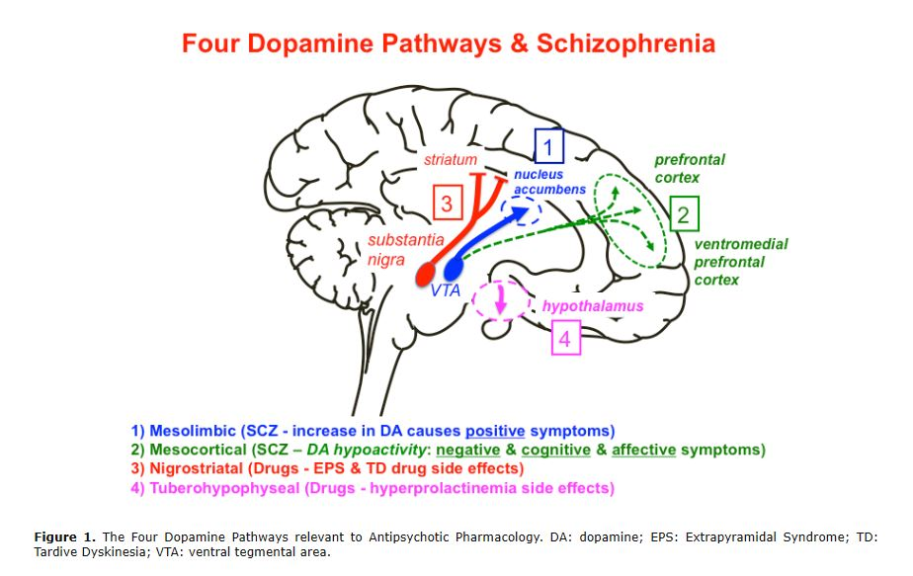
Adapted from http://tmedweb.tulane.edu/pharmwiki/doku.php/rx_of_schizophrenia

Slide 17
Extrapyramidal Side Effects (EPSE) of Antipsychotics^{2,5}
EPSE | Duration of onset | Signs | Treatment
Acute dystonia (occurs in 10% of patients, especially in young males) | Hours to days | Fixed muscle postures with spasm (oculogyric crisis, torticollis, opisthotonos) | Diazepam or Anticholinergics (benzhexol/ benztropine) Supportive Switch to 2nd generation
Parkinsonism (occurs in up to 90% of patients) | Days to weeks | Tremors, rigidity, bradykinesia, mask-like facies, festinating gait | Anticholinergics Reduce dose Switch to 2nd generation
Akathisia (occurs in 20% of patients, esp. middle aged females) | Hours to weeks | Subjective feelings of restlessness & objective motor restlessness (swinging of legs, pacing, rocking) | Reduce dose (distinguish from worsening psychosis which requires increase dose) Propranolol or benzodiazepine Switch to 2nd generation
Tardive Dyskinesia (TD) (Occurs in 5-60% of patients, esp. elderly female with mood disorders) | Months or years | Orofacial dyskinesia, lip smacking, tongue rotating, choreoathetoid movements of head, neck & trunk | Prevention: Use the lowest possible dose for the shortest possible time Benzodiazepine, propranolol, vitamin E Use of anticholinergic increases risk of TD Switch to 2nd generation

Slide 18
Neuroleptic Malignant Syndrome (NMS)
What it is
Emergency with 10-20% mortality rate
    occurs in <1% patients
Idiosyncratic reaction, not related to dose
Sympathetic hyperactivity
Management
Admit to hospital - withdrawal of the offending AP
Supportive care for hyperthermia, hydration
Pharmacotherapy
  Benzodiazepines
  Dopamine agonists (e.g. bromocriptine)
  IV muscle relaxants (e.g. dantrolene)
DSM-5 criteria for NMS¹
Use of neuroleptic
Elevated temperature
Severe muscle rigidity
AND 2 of the following:
  Diaphoresis
  Dysphagia
  Tremor
  Incontinence
  Changes in level of consciousness ranging from confusion to coma
  Mutism
  Tachycardia
  Elevated or labile blood pressure
  Leukocytosis
  Laboratory evidence of muscle injury

Slide 19
2nd Generation Antipsychotics &
Side-Effect Profile^{2,5,8}
Drug | Target dose (mg/day) | Metabolic Effect (monitor weight, BMI, BP, fasting blood glucose & lipids - baseline - 3 months - yearly) | EPSE | Prolactin secretion & sexual dysfunction | Sedation | Anticholinergic (dry mouth, constipation, urinary retention, blurring of vision, precipitate glaucoma) | Hypotension & reflex tachycardia (start low & go slow esp for Quetiapine & Clozapine) | Agranulocytosis (for Clozapine: mandatory to monitor absolute neutrophil count - weekly for first 6 months - biweekly for next 6 months - monthly for life)
Quetiapine (Seroquel®) | 150-800 (in 2 divided doses) | ++ | +/- | - | +++ | + (at high doses) | +++ | -
Risperidone (Risperdal®) | 2-6 | ++ | +++ (at high dose) | +++ (at high dose) | ++ | - | ++ | -
Aripiprazole (Abilify®) | 10-30 | +/- | + | - | + | - | + | -
Ziprasidone (Geodon®) | 40-160 | + | + | + | ++ | - | + (may prolong QTc) | -
Olanzapine (Zyprexa®) | 10-20 | +++ | ++ | + | ++ | + (at high dose) | +/- | -
Clozapine (Clozaril®) | 200-450 (in 2 divided doses) | +++ | +/- | + | +++ | ++ | +++ | +++

Slide 20
Algorithm of Approach in Management of Schizophrenia
Patient with Hallucination or Delusion
Exclude Organic Causes
Exclude Drug / Substance Abuse
Treat accordingly
Functional Psychosis
Fulfils DSM-5 for Schizophrenia
Does not fulfil DSM-5 for Schizophrenia
Use a single Antipsychotic (AP) 1st or 2nd generation according to side-effect profile & efficacy, 4-6weeks
Treatment of
associated issues:
Depression or Anxiety (SSRI)
Mania (Mood stabilisers)
Agitation & Insomnia (Hypnotics)
Suicidal tendency (ECT)
Multidisciplinary team
Psychosocial Intervention
Evaluate
Side effects Inadequate response
Switch to another AP 1st or 2nd generation
Side effects Inadequate response
Clozapine +/- AP or ECT (managed by specialist)
Maintain effective dose at least 6 months, continue for 2 years not lower than half of effective dose
Life-long for patients with 2 episodes within 5 years⁴
*Do not combine SSRI, SNRI, TCA or MAOI at the same time

Slide 21
When to refer^{2,5}
To confirm diagnosis of Psychosis & initiate treatment
Risk of harm to self & to others, or a public nuisance
For multidisciplinary management
Failed pharmacotherapy or complications from pharmacotherapy
Special patient groups: obstetric, paediatric & geriatric

Slide 22
In IMH Mental Health-GP Partnership Program (IMH-GPPP)⁵
Patients co-partnered with GP are those with:
Stable psychiatric conditions
Maintenance anti-psychotic medications, requiring minimum adjustments to dosage
Excluding those with:
Suicide or aggression risk
Disruptive Personality Disorder
On Clozapine prescription
Managed with Benzodiazepines only
IMH-GPPP is ongoing, those interested, please contact IMH-GPP@imh.com.sg

Slide 23
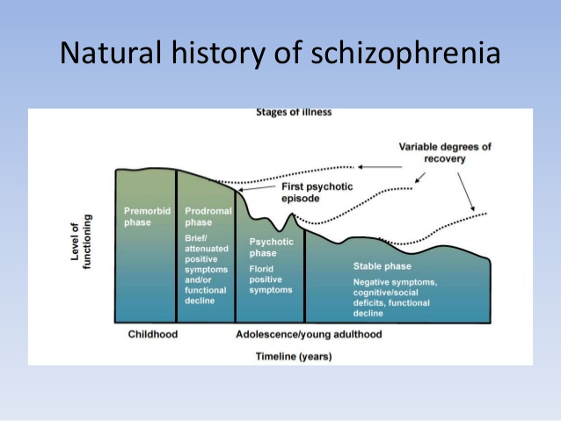
Adapted From Slideshare: Update on Schizophrenia

Slide 24
CAN PSYCHOSIS
BE PREVENTED OR DELAYED?
…see Psychosis Part 2 on
“The Insidious Onset of At-Risk Mental State”

Slide 25
REFERENCES
Diagnostic and Statistical Manual of Mental Disorders, Fifth Edition. Available from https://dsm.psychiatryonline.org/doi/book/10.1176/appi.books.9780890425596
Smith R, Osborn G, Dwamena F, D'Mello D, Freilich L, Laird-Fick H. Essentials of Psychiatry in Primary Care: Behavioural Health in the Medical Setting. United States: McGraw-Hill Education; 2019.
The WHO World Health Report: New Understanding, New Hope. Geneva, 2001
Burden of Disease Study. Ministry of Health, Singapore; 2004
Sim Kang, Somnath Sengupta, Daniel SS Fung, Chee Kuan Tsee. Essential Guide to Psychiatry. Institute of Mental Health. Pearson Education South Asia Pte Ltd; 2014.
Choo C, Verma S, Chong S. Delusions, possession, or imagination? Experiencing and Recovering from Psychosis. Singapore: SNP Corporation Ltd; 2009.
Institute of Mental Health Video Gallery. https://www.imh.com.sg/wellness/video-gallery/default.aspx?vid=31
Worrel J, Marken P, Beckman S, Ruehter V. Atypical antipsychotic agents: A critical review. American Journal of Health-System Pharmacy [Internet]. 2000;57(3):Pages 238–255. Available from: https://doi.org/10.1093/ajhp/57.3.238

Slide 26
Acknowledgement
Authors (VASE Team)
Dr Charity Low
(Peace Family Clinic (WL 832), GDMH 18/19)
Dr Roy Teow Kay Leong
(United Health Family Clinic & Surgery, GDMH 16/17)
Dr Paul Ang (Zenith Medical Clinic, GDMH 16/17)
Dr Eugene Chua
(Family Physician in public institute, GDMH 18/19)
Dr Lim Choon Guan (Senior Consultant and Deputy Chief, Dept of Developmental Psychiatry, IMH)
Dr Kumi Mehara (Japan Green Clinic, GDMH 18/19)
Dr Siti Aishah (Polyclinic, GDMH 16/17)
Dr Nyein Nyein (Clinical Psychologist, Thrive Family)
Mr Ng Boon Tat (Pharmacist)
Actors
Dr Eugene Chua as The General Practitioner
Choy Yu (Staff Nurse, KTPH) as Jane
Jackie Low as The Mother
Contributors
Dr Tommy Chan Chun Ting (Consultant, EPIP, IMH)
Dr Chan Keen Loong (Senior Consultant, Department of Psychological Medicine, KTPH)
Dr Zheng Shushan (Associate Consultant, EPIP, IMH)
Psalms Chia (Student)
Venue of filming
IMH clinic consultation room
IMH grant

Slide 27
DISCLAIMER
The information in this video is correct to the best of our knowledge at the point of circulation. It is by no means exhaustive. Please refer to the above references & other materials to consolidate your appreciation of the subject. The authors disclaim any liability in connection with the use of this information.
All rights reserved. No part of this video may be reproduced, distributed or transmitted in any form by any means without the permission of the authors

